Slide 1
Workshop Objectives
An understanding of the CAYAD kaupapa and community action that inspires you
New connections with members of the CAYAD whanau
Increased knowledge of a Māori worldview of public health
Increased awareness of alcohol and other drug information and effective strategies
Increased knowledge, skills and confidence in CAYAD planning and monitoring
Notes:
These are on your programme

Slide 2
Programme - Day One
Welcome – 9.30
Whakawhanaungatanga
Overview of CAYAD and Population Health
Introduction to Community Action
Engaging Māori in a public health context – Teah Carlson
Morning tea – 11.00
Introduction to Community Action
Introduction to RBA and CAYDA reporting
Lunch – 1.15
Alcohol and other drug (AoD) information – Ben Birks
CAYAD project case studies

Slide 3
How CAYAD contributes to population health
S1 – P.6
Notes:
Medical model is an individual approach working directly with individuals, e.g. in a GP, , or delivering programmes that work directly with individuals. Often this is about a service, like a doctor, treating a need, like treating someone with a bad case
Public health aims to support and protect the health of whole population groups. Often this goes back to looking at the root cause of problems.
Dr John Snow – Soho london – had a massive outbreak of a cholera in a specific location, suspected it was the well. Tracked a lot of cases back to that well. Eventually convinced officials to take the handle off the pump and it all dried up.

Slide 4
Notes:
This slide is about preventing harm
In Public health, and in CAYAD, our job is to be the fence at the top of the cliff, not to treat injured people at the bottom.
Our job is to help our communities build a safer and more positive environment around their young people, to help them put the fence up here at the top around that rock.
Will we ever stop alcohol and drug harm completely? No, but our goal is to reduce the harm that is happening as far as possible, including delaying how young people start using.
2. This slide is also about the importance of the environment around us
The cliff dominates this picture, it’s the big risk. In the same way, our health is hugely shaped by the world around us. With alcohol and drugs, we are often told it’s our individual responsibility to look after ourselves; and if you don’t, you’re weak, you have no discipline, it’s your fault.
But then when we look at the alcohol environment, we see how heavily it’s advertised, how cheap alcohol is and how it’s been made available everywhere around us; all of that influences how much we drink.
Another aspect of the environment is the economic opportunities around us, which can be a big driver of poorer health outcomes. In a small rural town like Opotiki, 50 years ago there was plentiful good work around, decent pay and good housing. For many families today, the jobs have gone, and if a problem occurs like the car breaking down or a health issue, the money to patch things up isn’t there. Alcohol and drugs can become part of filling those gaps, either to make money or help cope with tough circumstances.
3. Part of the environment is the systems around us. Systems exist in communities and in the organisations around us, like health and social services, schools, employers, community activities and networks. Improving those systems can really improve lives and health.
So to summarise, we support whole populations, and we look for ways to prevent harm – up at the top of the cliff.

Slide 5
Example
Lowering of the drink driving (blood alcohol limits
Outcome - immediate reduction in alcohol consumption
A zero-alcohol limit for youth led to immediate reductions of close to 50% in both drink driving and crashes amongst young people.
Notes:
A simple example is…

Slide 6
Community Action
S2

Slide 7
Pre-Course Work: East Coast Rugby
a) What specific issue was being addressed?
b) Who were the key stakeholders?
c) List 1 or 2 key activities that brought about positive change in the community
Notes:
Keep the same 3 questions in mind as you listen to Moki’s story.

Slide 8
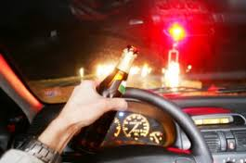
Specific focus
1. Reducing alcohol and other drug harm
2. systemic change – in policies, environments, structures, systems and/or practices
3. Change will be sustained over time

Slide 9
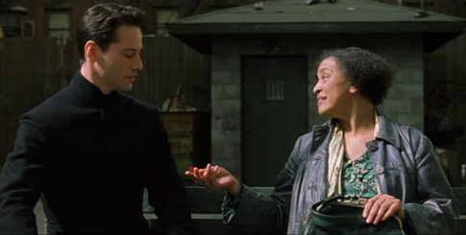
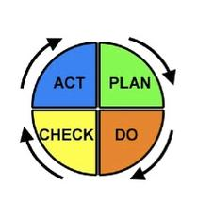
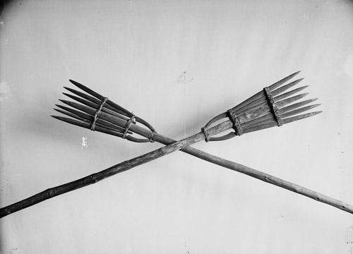
Specific Method. CAYAD projects are:
1. Based on evidence
Research, local and cultural knowledge
2. Well coordinated
Have a plan, monitoring and reflection, and reporting/evaluation
4. Multi-pronged Use more than one strategy
3. Collaborative Involve selected partners across multiple levels and sectors

Slide 10
Community action on alcohol harm - strategies that work (Holder, 2001, Babor et al, 2010)
Community mobilization
Broad: building public support and awareness
Targeted: Meetings key decision makers
Media advocacy
Evidence based solutions
Increased enforcement on drink driving & purchase age
Enforcement was publicised - you will get caught
Responsible Beverage Service training & policy
Changing council policy e.g. a cap on new off-licences, and compulsory training for bar staff
Notes:
The project here was called the ‘community trials’ project in the U.S.A. It was one of the original sources of good evidence for community action on alcohol. This has been backed up since in other studies.
A key finding was that these community action projects is that A MIX OF STRATEGIES IS MOST EFFECTIVE! One strategy on its own is not sufficient to create change.
The strategy was mobilisation – a broad group of health promoters from different services came together to guide the project.
One of their strategies was to raise wider public awareness and support for their project. Part of mobilising was media advocacy – getting good media stories to build public support for issues around alcohol, and to publicise the effective solutions. This included providing training in media skills, like how to get media attention for your story, and giving sharp messages that will help activate others to support your cause. Think about how the Campbell Live drink-drive stories put some pressure on the Govt. to reduce the blood alcohol limit.
Specific objectives based on evidence
They also mobilised smaller project task forces which had specific goals – like tactical strike teams. These small groups each had a very clear objective.
One was to target leaders in the Police, and the got them to agree to increase drink drive enforcement
Another advocated to the local council, and got them to make server training compulsory for bar staff – and this was a permanent change to their policy for licensed premises. They also got the local council to support a ban on new off-licences in high density areas.
Lastly they designed good training for ‘Responsible Beverage Service’ and engaged the bars in the training.
So what was the result?

Slide 11
Community Action Outcomes:
Reduced alcohol-involved violence
Decreased drinking and driving
Decreased underage alcohol sales
Increased media coverage of alcohol issues
Increased on-premise serving policies
Cap on issuing new off-licences
Potential future effects:
Lower density of alcohol outlets
Notes:
It worked - there were some truly impressive outcomes that were achieved!

Slide 12
CAYAD Reference Groups
S1
A select group of people from different agencies or the community, with a shared interest in youth and community wellbeing.
Purpose
Advise on community need
Help you agree the CAYAD focus: key objectives and key initiatives relevant to CAYAD
Link to key agencies
Support implementation of projects
Notes:
Support might include helping you access decision makers, key staff with particular expertise who will advise you or take part in project activities, help you apply for funding

Slide 13
CAYAD Reference Groups
Health
Council
Education
Reference Group
Employment
LAW ENFORC. / POLICE
COMMUNITY
IWI/HAPU
Youth sector
Notes:
Who are they?
Ref group membership may include members of local agencies or institutions (as above). They also include motivated and influential members of the community.
Good idea to work with your manager on identifying suitable members
How do they operate?
However works best for your community. Three common examples are:
A group that meets regularly specifically to guide and support CAYAD projects (e.g. PACT). (e.g. Hutt Valley)
An existing network, like a youth support services network, that includes CAYAD projects as part of its wider agenda
A group formed around a specific project: ARMWG
CAYAD Coordinators role:
Develop the group
Convene quarterly meetings
Facilitate meetings or share this with the group
Reporting and note taking - key issues or decisions summarised
Useful to have a short terms of reference – clarify the purpose of the group (helps people get permission from their agencies to (a) join the group (b) share useful info that may otherwise not be able to share; can support decision making processes)

Slide 14
Case Study Questions
What was the issue being addressed?
What were the key actions that helped the project to succeed?
What changed as a result of this project?
- Is this what was intended at the beginning? What (if any) unintended outcomes occurred?

Slide 15
CAYAD Programme Objectives
Increased informed community discussion and debate about issues related to alcohol and other drugs
Effective policies and practices to reduce alcohol and other drug related harm adopted
Increased local capacity to support young people in education, employment and recreation
Reduced supply of alcohol and other drugs to young people
Notes:
What kind of environmental changes?
Reducing supply: fewer stores, fewer hours, higher price
Policies and practices: Local policies for marae, schools and sports clubs to change community norms; regional and national level policies and enforcement
Participation in education, employment and recreation: more options for young people, better support systems in place

