Slide 1
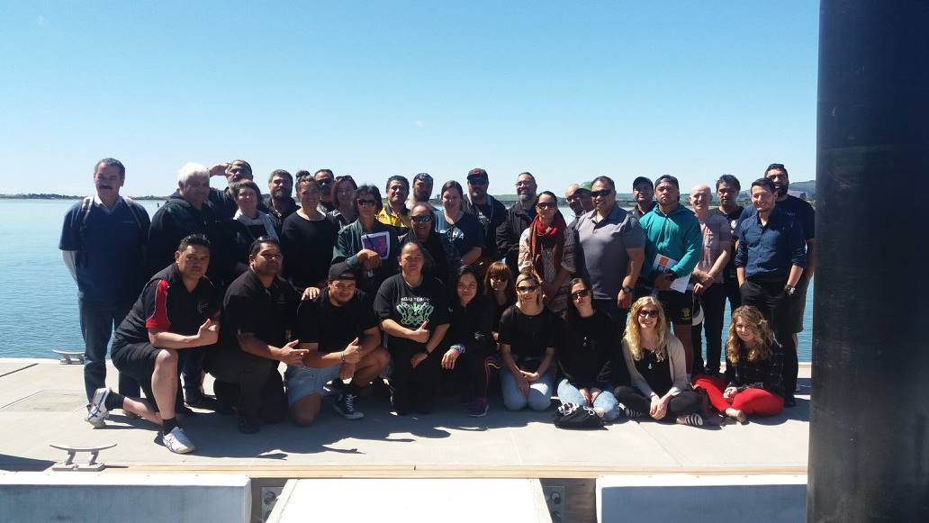
Haere mai ki te whānau o CAYAD

Slide 2
Workshop Objectives
An understanding of the CAYAD kaupapa and community action that inspires you
New connections with members of the CAYAD whanau
Increased knowledge of a Māori worldview of public health
Increased awareness of effective community action strategies to reduce harm from alcohol and other drugs
Increased knowledge and skills for RBA planning and monitoring
Notes:
These are on your programme

Slide 3
Day One Overview
Mihi Whakatau – 9.00
9.20 Whakawhanaungatanga
Overview of CAYAD
Alcohol and other drugs & young people in Aotearoa
Morning tea – 11.00
11.20: Population Health
Effective Community Action
Introduction to RBA and reporting
Lunch – 1.30
2.30 Planning CAYAD projects
4.30 Departure

Slide 4
Haere mai ki te whānau o CAYAD
Notes:
Introduction I am going to cover some fundamentals we need to know to do our jobs in CAYAD.
-Who are we trying to reach with our mahi?
-How do we do the mahi?
-What your responsibilities are as a CAYAD coordinato
I think the best place to start that off is to look at the whakapapa of CAYAD, to see where we come from [click]

Slide 5
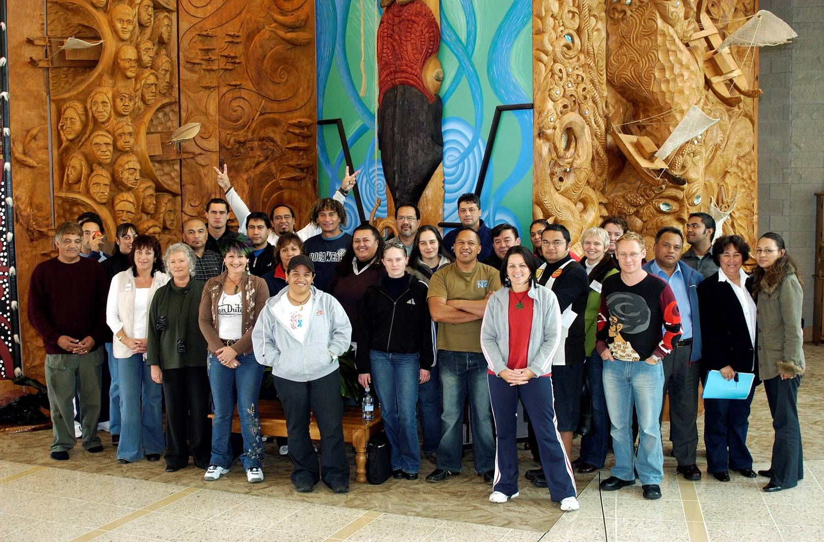
History of CAYAD
Notes:
This picture is from a CAYAD national hui in the early 2000s –there will be some faces here that you know! But we’re older even that these clothes,
CAYAD actually back in 1997, when the Ministry of Education was asking for ways to reduce high rates of drug related stand downs and suspensions in schools.
In response, two directors from SHORE & Whariki, Sally Casswell and Helen Moewaka Barnes, alongside Kim Conway, wanted to look beyond materials, to robust, community-led approach to achieving change. It was based on a collaborative effort within community, supporting them to create a planned approach for effective change.
Based on the pilot, In 1998, six sites were funded- Hokianga, Kaitaia, Nelson, Opotiki, West Auckland and Whangaruru. In the early days, the local coordinators, who hold the close relationships in their community, were paired with evaluation staff from SHORE & Whariki. This was to help establish planning and reflection as bedrock elements of community action, and to help us demonstrate success of the programme. The programme was evaluated positively, and the Ministry of Health picked up ongoing funding of CAYAD, increasing the programme to 18 sites 2003, and another six sites in 2005. Today we have 21 sites operating around the country.
To support this larger number of sites, national hui started in 2003, and regional hui in 2007. The point of these hui was to get us together to share and reflect on our projects, what was working, and what wasn’t. The hui and the sites are supported by an advisory group, and by us as national coordinators, and by the Ministry of Health.
So today, looking at this history, and the sessions in the workshop, we want you to take away three key things that are at the core of CAYAD’s DNA – no 1. strong relationships, no. 2. effective planning and no. 3. monitoring and evaluation of your work.
In 2015, we held a national gathering to develop our shared vision and mission. This was a really well facilitated, inclusive process, and from all the input we got something that reflects not only our contract but the vision of all of us in the programme: [next slide]

Slide 6
Notes:
1. Re. Three downward arrow marks (just under the text: ‘with feathers the bird can fly’)
This pattern is inspired by the mumu tukutuku design (usually based on traditional bird footprints). Here it is a representation of birds flying together, portraying alliance, support and the interconnections that we make to achieve our full potential.
3. Re. Sky/mountains - Our pepeha incorporates our maunga to say who we are and where we come from ~ anchoring us to our whenua and acknowledging our whakapapa.
In this poster the layered maunga climb upwards reflecting a metaphoric connection to the stepped poutama pattern. Poutama has significant spiritual and educational meaning and here it symbolises strength, growth, unity, improvement and advancement.
4. The outward arrows: <<<>>> (under the whakatauki in the mission triangle) are derivative of one of the four major patterns featured in tāniko design ~ Waharua kōpito. This stylised version represents ‘a point where people or events cross’ and communication is key for change to occur at such meeting points.
*Next, we’ll start with a look at our larger context in public health. [next slide]

Slide 7
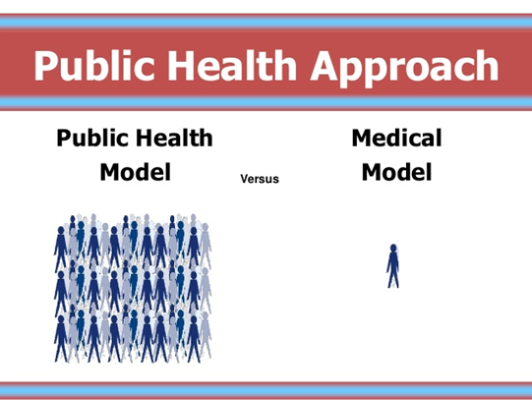
S1 – P.6
Notes:
Medical model is about working directly with individuals, e.g. your GP who treats people who come in with a health problem, or a youth mentor working directly with small groups of rangatahi. These programmes provide individualised support or services for one person or a few people.
CAYAD is not those things. CAYAD is a public health programme, so our focus is on supporting the many. We are not a drug counselling service, or youth coaches.
We aim to support and protect the health of whole population groups. This might be a group by location, like secondary students in West Auckland, or in Kawakawa. Or it could be about groups connected by interest like working with the rainbow community.
Another key feature of public health is that we focus on prevention, often by trying to address the root cause of a problem. River analogy (swimming out to rescue people floating down river; walk upstream, hole in bridge, fix the hole).
This is sometimes called “primary prevention” {next slide]

Slide 8





Who does CAYAD aim to reach?
Primary prevention: focus on populations
CAYAD
Secondary: for people at risk or
already using alcohol or other drugs
Tertiary prevention: people already affected by the problem
Notes:
Triangle represents how many people are reached by these different approaches.
Primary = whole population, focus on preventing problems before they occur.
Secondary prevention = middle –people at risk of harm, for CAYAD that might mean starting to use alcohol and other drugs in potentially risky way
Tertiary = smaller numbers, people already affected, by the problem
Complete the sorting exercise.
Move into three groups, provide action cards.
Instructions – your task is to place them where you think they fit on the triangle. So place the cards in either primary, secondary, or tertiary prevention. Any questions? You have 5 minutes.
3. Check in – read back and explain ‘why’ for each group.
Obviously in public health, if we have some effective strategies for primary prevention, this is the ideal time to intervene. As you move down the triangle, support is ever more costly, and requires a lot more individual effort. At the top here, it might take some community effort to get these strategies started, but if they are sustained, there is a really good long term pay off.
On our website, there’s a great video of Mason Durie talking about this at our 2016 National Hui. He sums up that for us to help populations reduce AOD harm, we must work with others reduce risk factors in our environment:”Whakawatea te ara” --- and Build Protective factors, “Kia hora te oranga”

Slide 9
Community Action
S2
Notes:
So now we know two very important things
No 1. who we are trying to reach - (point to triangle) whole communities, and young people in particular
No 2. That CAYAD’s specific aim is around preventing and minimising harm
Next we’ll just take an overview of how we do this. We’ve talked a bit about it in our history, that we have this planned approach called Community Action. Hopefully most of you have also seen some of the video examples of community action, and talked to your managers about it. You’ve probably noticed it can look quite different from one project to another. But, it also has some common, defining features that you will have noticed too.,
So, we thought we’d start with a quick discussion at your tables: [next slide]

Slide 10


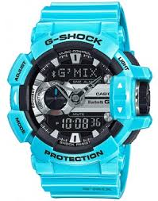
Specific focus
1. Reducing alcohol and other drug harm
2. systemic change – in policies, environments, structures, systems and/or practices
3. Change will be sustained over time
Notes:
Community action has a specific focus on achieving long-lasting change. Not just the latest hot idea for youth development, but: [explain 1,2,3 ]
2. Systemic change: School might as you to come in to talk to their kids about drink driving. But a one-off presentation to kids about drink-driving is not going to be a systemic change. Instead, you might talk to the school about their driver licensing programme, and link them up with the local police officer to create a module on drink driving as part of that course. That is a systemic change. You now have a drink-driving awareness training built into the school curriculum every year. So that is now part of the system, and it will be sustained over time by the school.
3. Sustained over time:
It also has a very specific method [click next slide]

Slide 11

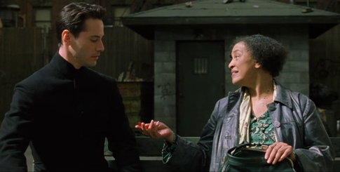
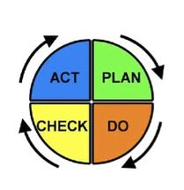

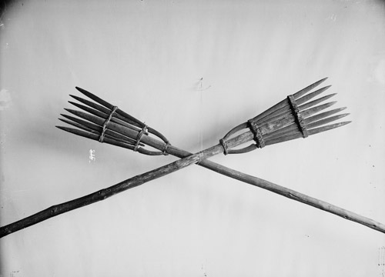
Specific Method. CAYAD projects are:
  Based on evidence
  Research, local and cultural knowledge
  Well coordinated
  Have a plan, monitoring and reflection, and reporting/evaluation
Multi-pronged Use more than one strategy
Collaborative Involve selected partners across multiple levels and sectors
Notes:
It also a specific method. These are 4 of the really important features that we will unpack… [list off/explain any not covered already ] We’ll unpack some of these a bit more as we go along.
But taking a step back from all these guiding principles, you probably want to know where do I get started?

Slide 12
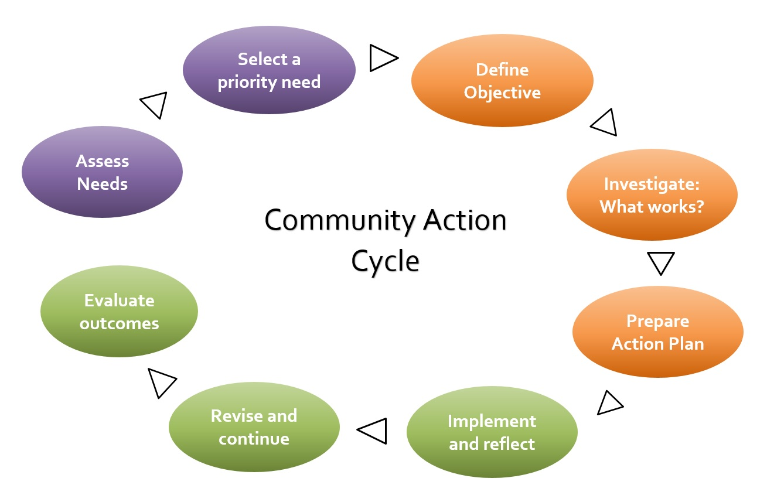
Notes:
(pic. on walls) The whole process begins here, assessing local needs, or opportunities. Once you have a priority selected, you know where you will be going.
You are at the centre of this process, as a community action coordinator. You won’t be doing any of this on your own
You will remember from the history earlier, that all of this hinges on local whakawhanaungataga (write the word across the sheet on the wall) – building relationships.
As the coordinator in the middle, you will be helping other people and organisations move through these steps. [next slide]

Slide 13
Collaboration & collective impact
Health
Council
Education
Project team
Employment
LAW ENFORC. / POLICE
COMMUNITY
IWI/HAPU
Youth sector
Notes:
These are the sectors that we often work with, to help build collaboration and make change together.
This is because many of the determinants of health lie across these different sectors, industries, and agencies
-> So collaborative leadership that bridges sectors, Iwi, NGOs, schools, businesses, youth is really important to address environmental health risks
As Mason Durie put it to us at our 2016 National hui, their collective impact will be greater than the sum of agencies acting in isolation.
So you, as a coordinator, will be in the middle of this picture, helping these people to connect, to get engaged in collective projects. You will work with them to
-Identify priority issues in that need attention
-find effective strategies
-And their influence – or even their staff – will ensure the solutions are implemented

Slide 14
Stakeholder activity
In pairs: Name a stakeholder you met in your community, and something useful you learned from them
Notes:
In “other resources“ tab: Point out the ‘stakeholder analysis tool’ .

Slide 15
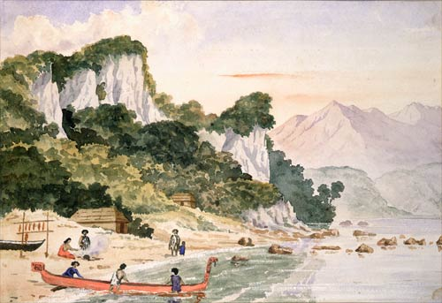
… Based on evidence
Notes:
[Painting of a bay in Canterbury, a small canoe is being readied for a fishing expedition. A recent catch hangs on a drying rack beside the other canoe. By Frederick Weld, 1850.]
Briefly describe opportunity cost
Get evidence from:
-local knowledge / local partners
-consult the research evidence
-call NCT/NCAG other CAYAD sites
There is a strong ev. base from alcohol… [click to next slide]
Weld, Frederick Aloysius (Hon Sir), 1823-1891. [Weld, Frederick Aloysius] 1823-1891 :Amuri. Nov 11, ev[enin]g 1850. Ref: A-269-012. Alexander Turnbull Library, Wellington, New Zealand. /records/23148106

Slide 16
Evidence for reducing harm from alcohol
Strategy/intervention | Effective- ness | Research support | Cross cultural testing | Cost to implement
Taxation and price increase | +++ | +++ | +++ | Low
Minimum legal purchase age | +++ | +++ | ++ | Low
Low blood alcohol levels for young drivers | +++ | ++ | + | Low
Restriction on outlet density | ++ | +++ | ++ | Low
Brief intervention with at risk drinkers | ++ | +++ | +++ | Moderate
Community mobilisation to alter drinking context | ++ | ++ | + | High
Alcohol advertising bans | + | ++ | ++ | Low
Promoting alcohol free activities and events | 0 | ++ | + | High
Media campaigns to persuade | 0 | +++ | ++ | Moderate
School based education | 0 | +++ | ++ | High
Alcohol: No Ordinary Commodity (Toolkit: AOD Evidence section)
Notes:
Source: Alcohol: No Ordinary Commodity (Thomas Babor et al.) Online summary of 2nd edition
This research has been compiled by the leaders in this field, across the best studies available, across many different countries. Our work fits in the middle here, community mobilising to alter the drinking context.
I’d like you to take a look through, what do you notice about the interventions?
Do any of them involve working with a youth development or coaching individuals? What’s the cost of those interventions? >> Greatest impact is from targeting the environment.
The findings have been consistent across countries and different cultures. If you just target the individual with education and media campaigns and do nothing about the environment - you won’t reduce harm.

Slide 17

…Focus on environments
Notes:
This is to reminder about the importance of the environment around us. When we talk about putting a fence at the top of the cliff, it’s about creating safer environments around young people…
Key factors can be the economic conditions, and other social and commercial influences on our health. These macro factors can produce big changes. For instance, in a smaller town like Wairoa, 50 years ago there was plentiful good work around with railways jobs, meat works with ok pay and good housing. For many families today, those jobs have gone, and what is left isn’t so well paid. If a problem occurs like the car breaking down or a health issue, the money to patch things up isn’t there. These stresses on families can contribute to alcohol and drug misuse.
So we’ll take a look at some of the environments that we try to work on to prevent harm
2. *provide handout: environments & projects

Slide 18
Environments that impact young people
Whanau
Community norms and practices
School environment
Alcohol marketing and sponsorship
Supply and availability of alcohol and other drugs
Service systems (social, health, police, youth justice)
Employment market / socio-economic stress
Notes:
(make this a handout – plus next slide as some of the solutions – too many words for a slide.
Ben mentioned several of the risk and protective factors for young people already (top 3). We also have a broader focus on some of other factors that have an effect.
So if we want to make these environments safer for young people, where do we get started?
[Provide hand out]
You will find out from your community, which of these environments are helping YP, and which need to change.
On the hand out, you can draw a line from these environments, to the related CAYAD projects.
Working through the CAYAD project library, you will find some more examples of this work.

Slide 19
Your role
Notes:
This is a blank space that we will be filling in tomorrow
You’ll need some time to digest all the learning and whakaaro from today. Just think a bit about what it all means for your role in the community.
Give hand out

Slide 20
CAYAD Reference Groups
S1
A select group of people from different agencies or the community, with a shared interest in youth and community wellbeing.
Purpose
Advise on community need
Help you agree the CAYAD focus: key objectives and key initiatives relevant to CAYAD
Link you to key agencies
Support implementation of projects
Notes:
Who are they?
Ref group membership may include members of local agencies or institutions (as above). They also include motivated and influential members of the community.
Good idea to work with your manager on identifying suitable members
How do they operate?
However works best for your community. Three common examples are:
A group that meets regularly specifically to guide and support CAYAD projects (e.g. PACT). (e.g. Hutt Valley)
An existing network, like a youth support services network, that includes CAYAD projects as part of its wider agenda
A group formed around a specific project: ARMWG
CAYAD Coordinators role:
Develop the group
Convene quarterly meetings
Facilitate meetings or share this with the group
Reporting and note taking - key issues or decisions summarised
Useful to have a short terms of reference – clarify the purpose of the group (helps people get permission from their agencies to (a) join the group (b) share useful info that may otherwise not be able to share; can support decision making processes)

Slide 21
CAYAD Programme Objectives
Increased informed community discussion and debate about issues related to alcohol and other drugs
Effective policies and practices to reduce alcohol and other drug related harm adopted
Increased local capacity to support young people in education, employment and recreation
Reduced supply of alcohol and other drugs to young people
Notes:
What kind of environmental changes?
Reducing supply: fewer stores, fewer hours, higher price
Policies and practices: Local policies for marae, schools and sports clubs to change community norms; regional and national level policies and enforcement
Participation in education, employment and recreation: more options for young people, better support systems in place

